Slide 1

MINI PROJECT-1 PROJECT REPORT FILE
Department of Computer Science & Application
Institute of Engineering & Technology
SUBMITTED TO: - SUBMITTED BY: -
Mrs.Gurpreet Kaur Aryan Bhatt(201500144)
(Technical Trainer) Divya prakash gupta (201500228)
Shubham Srivastava (201500779)

Slide 2
Introduction
Movers and Packers is a project which is developed to provide an interactive platform between clients and packers and Movers Company. This project provides best andreliable services in relocating. Clients can book the services through this web portal. This Projectprovides useful information to clients in the process of relocating their house. Packers andmovers agency works according to the needs and requirement of the customers and provide themthe desirable results. The packers and movers agencies uses best quality packing materials topack our goods in such a way that all goods remain in safe condition during transit &movie services ensure the safe delivery of our goods at our destination

Slide 3
1.1 Planning stage of T T E Website
Before you delve into the Truck Trek Expert development stage, stop for a second and think about a few points.
Movers and Packers is a project which is developed to provide an interactive platform between clients and packers and Movers Company. This project provides best andreliable services in relocating. Clients can book the services through this web portal.Do you know your targeted users? This is one of the most important bullet points to think over while in your planning stage. Knowing your targeted users not only allows you to curate your content, but also guides your design and color schemes during the mobile app development stage.

Slide 4
1.3 Main objective of the project
Customer satisfaction
The mission statement of Truck Trek Expert focuses on addressing issues of customer satisfaction. The mission statement of Truck Trek Expert has identified its target customer groups, and also identified their needs and demands. The mission statement reflects on how its products and services work towards increasing customer satisfaction for its target customers
Realistic and clear
The mission statement for Truck Trek Expert is also realistic and clear. This means that Truck Trek Expert has used simple, string, and easily understood words and phrases in the drafting of its mission statement. Clarity is important so that the mission statement is understood by all relevant stakeholders of Truck Trek Expert Company. Trucker’s mission statement is also realistic, which makes it able to achieve various set goals and targets

Slide 5

Software Requirement
PHP
PHP is an open-source, interpreted, and object-oriented scripting language that can be executed at the server-side. PHP is well suited for web development. Therefore, it is used to develop web applications (an application that executes on the server and generates the dynamic page.).
PHP was created by Rasmus Lerdorf in 1994 but appeared in the market in 1995. PHP 7.4.0 is the latest version of PHP, which was released on 28 November.

Slide 6

Xampp
XAMPP is one of the widely used cross-platform web servers, which helps developers to create and test their programs on a local webserver. It was developed by the Apache Friends, and its native source code can be revised or modified by the audience. It consists of Apache HTTP Server, MariaDB, and interpreter for the different programming languages like PHP and Perl. It is available in 11 languages and supported by different platforms such as the IA-32 package of Windows & x64 package of macOS and Linux.

Slide 7

Visual Studio Code
Visual Studio Code, also commonly referred to as VS Code,is a source-code editor made by Microsoft with the Electron Framework, for Windows, Linux and macOS. Features include support for debugging, syntax highlighting, intelligent code completion, snippets, code refactoring, and embedded Git. Users can change the theme, keyboard shortcuts, preferences, and install extensions that add additional functionality.
In the Stack Overflow 2021 Developer Survey, Visual Studio Code was ranked the most popular developer environment tool among 82,000 respondents, with 70% reporting that they use it.

Slide 8

Technology Used
HTML
HTML stands for Hyper Text Markup Language
HTML is the standard markup language for creating Web pages
HTML describes the structure of a Web page
HTML consists of a series of elements
HTML elements tell the browser how to display the content
HTML elements label pieces of content such as "this is a heading", "this is a paragraph", "this is a link", etc.

Slide 9

CSS
CSS stands for Cascading Style Sheets
CSS describes how HTML elements are to be displayed on screen, paper, or in other media
CSS saves a lot of work. It can control the layout of multiple web pages all at once
External stylesheets are stored in CSS files

Slide 10

Java Script
JavaScript , often abbreviated as JS, is a programming language that is one of the core technologies of the World Wide Web, alongside HTML and CSS. As of 2022, 98% of websites use JavaScript on the client side for webpage behavior, often incorporating third-party libraries. All major web browsers have a dedicated JavaScript engine to execute the code on users' devices.
JavaScript is a high-level, often just-in-time compiled language that conforms to the ECMAScript standard.[10] It has dynamic typing, prototype-based object-orientation, and first-class functions. It is multi-paradigm, supporting event-driven, functional, and imperative programming styles. It has application programming interfaces (APIs) for working with text, dates, regular expressions, standard data structures, and the Document Object Model (DOM).
The ECMAScript standard does not include any input/output (I/O), such as networking, storage, or graphics facilities. In practice, the web browser or other runtime system provides JavaScript APIs for I/O.
JavaScript engines were originally used only in web browsers, but are now core components of some servers and a variety of applications. The most popular runtime system for this usage is Node.js.
Although Java and JavaScript are similar in name, syntax, and respective standard libraries, the two languages are distinct and differ greatly in design.

Slide 11

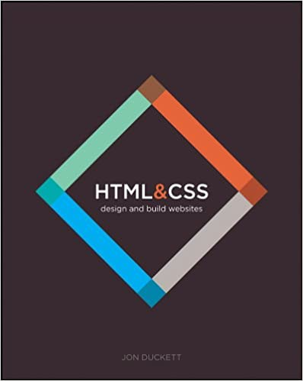
Hardware Requirement
A Laptop
HP pavallion Gaming
Dell Precision
A Reference book
Book by J . dott

Slide 12
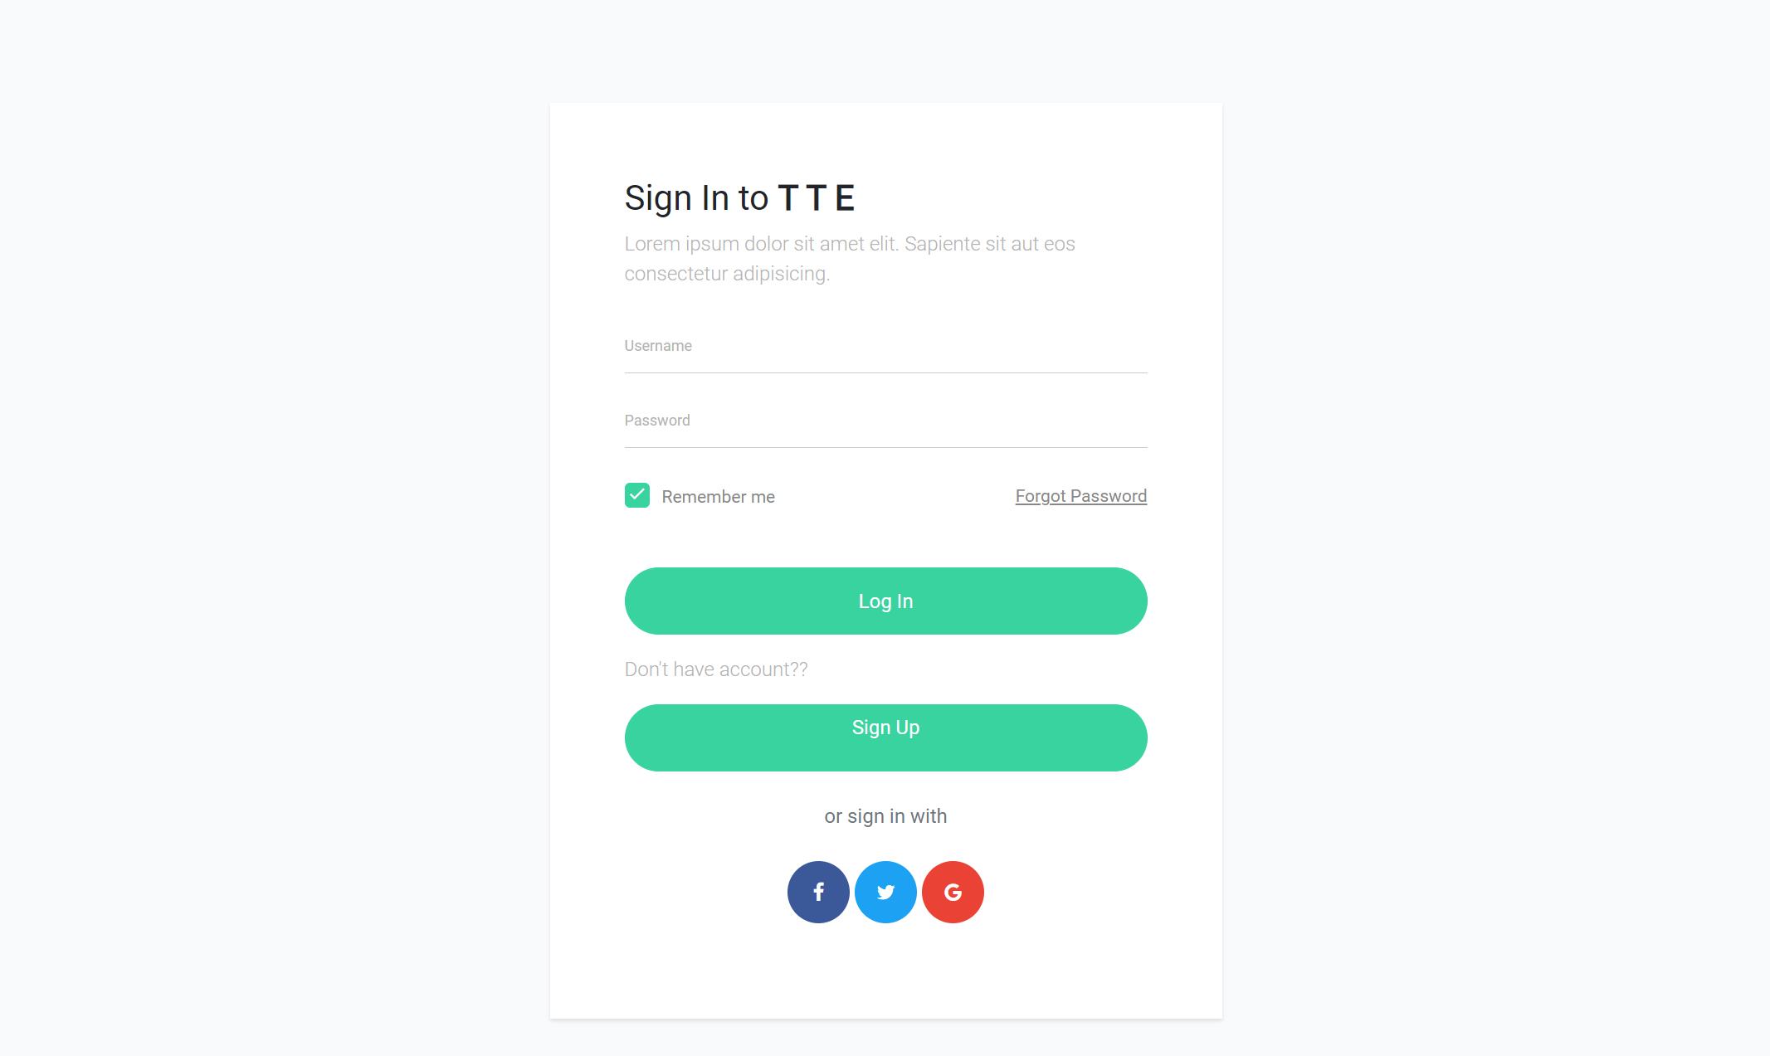
Let’s start with sign page

Slide 13
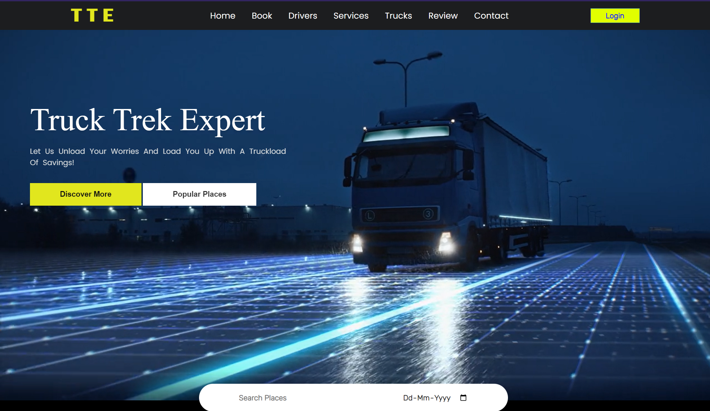
Home page

Slide 14
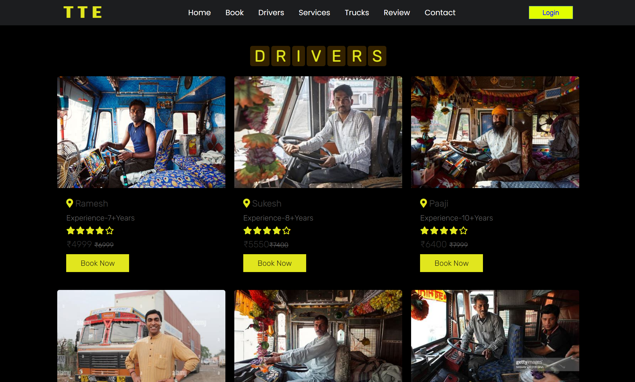
Our top Drivers

Slide 15
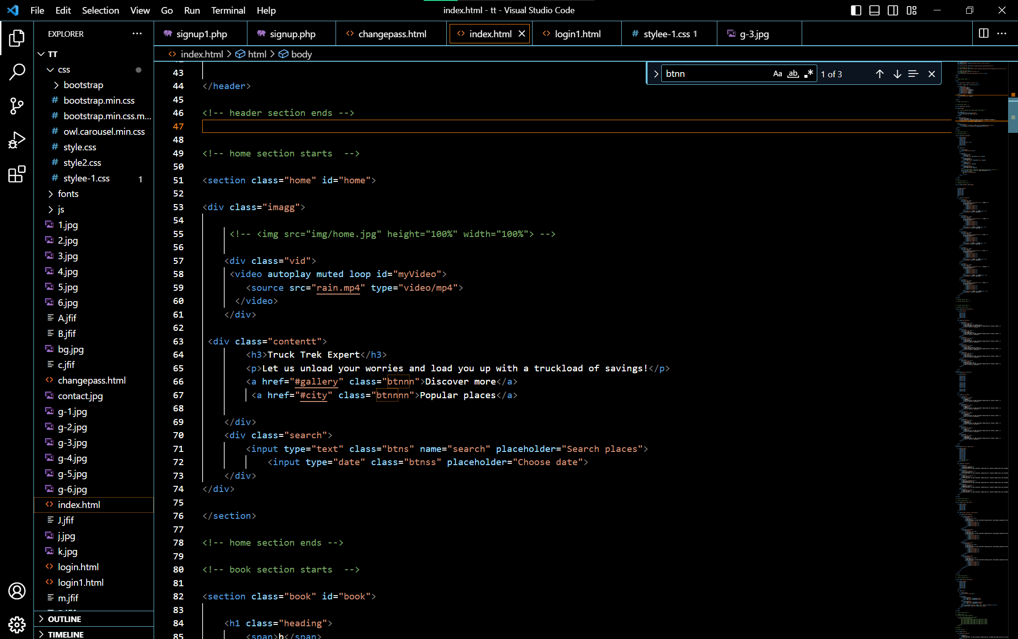
Code used:-

Slide 16
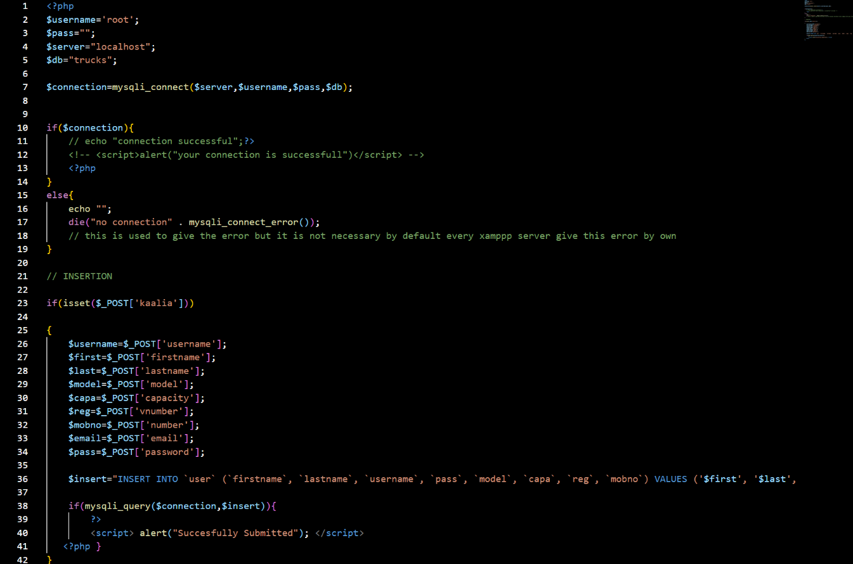
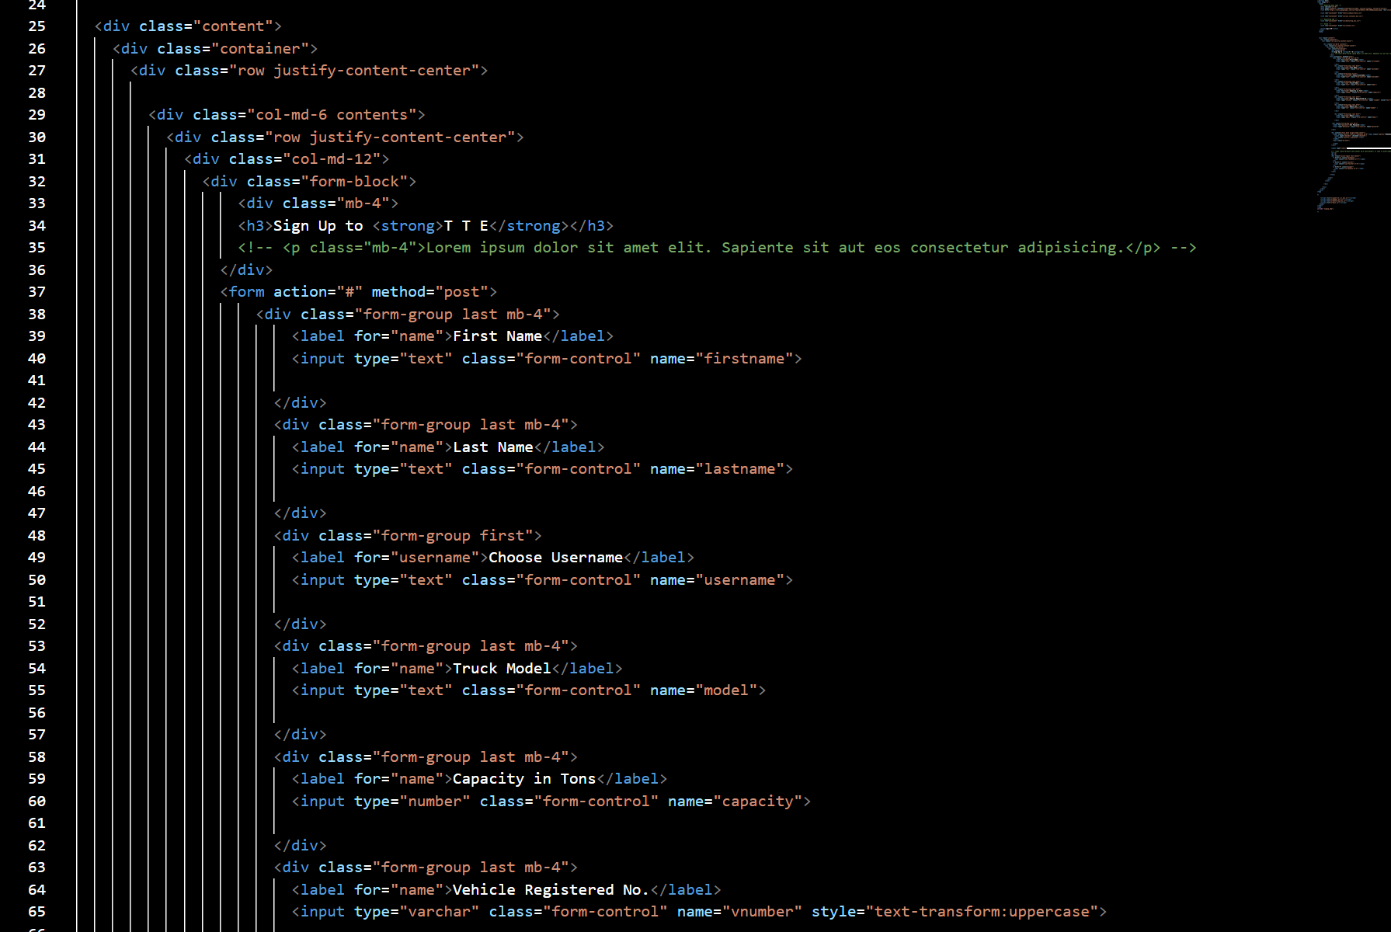

Slide 17
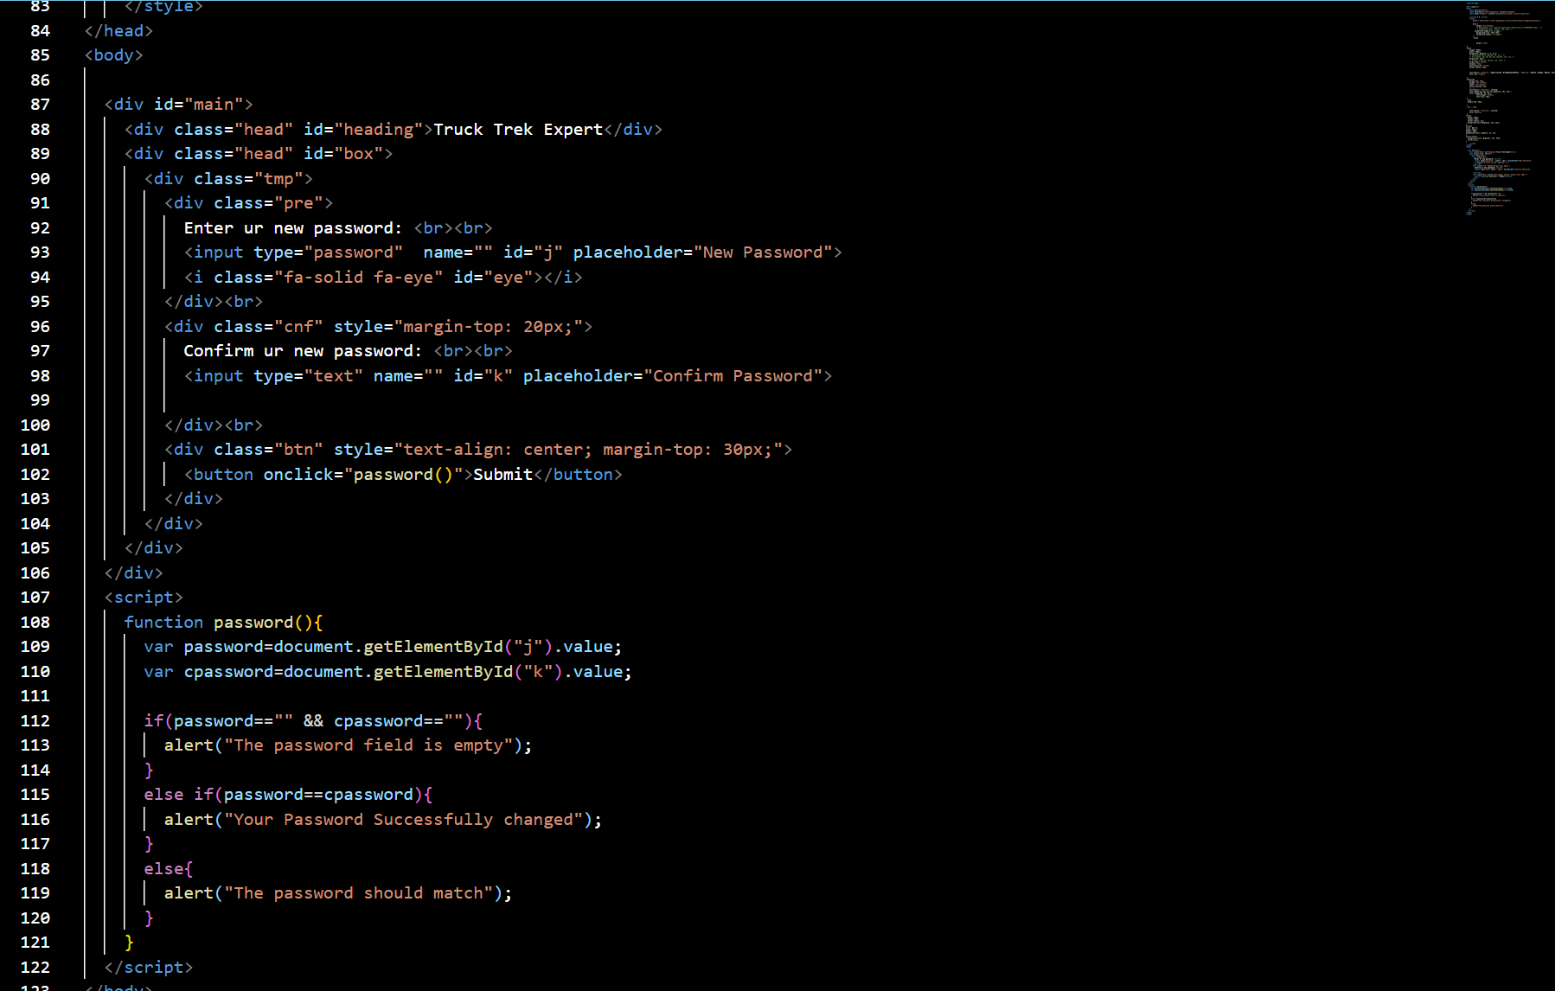

Slide 18
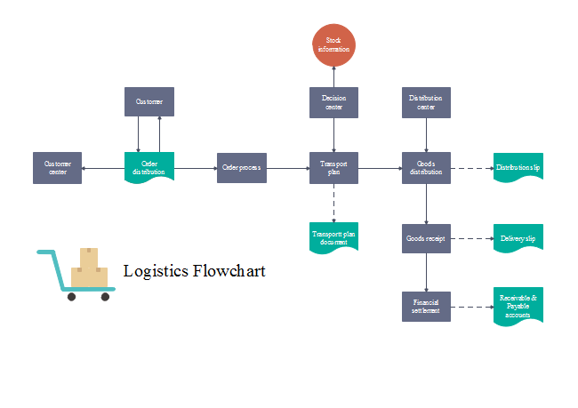
Dataflow Diagram

Slide 19
Our references
Websites:
www.w3schools.com
www.google.com
www.stackoverflow.com
developer.mozilla.org
Faculty Guidelines:
Mrs. Gurpreet Kaur (Technical Trainer in GLA University)
Website Link: https://divyakumarraj.github.io/Trucktrk
Github Repo Link: https://github.com/divyakumarraj/Trucktrek

Slide 20


